Slide 1
Social Determinations of Health Collaborative Kick-Off Call
Increasing Connections to Services
Presented by the NJ Department of Health (DOH) in partnership with Public Consulting Group (PCG)
June 26th, 2024
12:00 PM - 1:00 PM ET

Slide 2
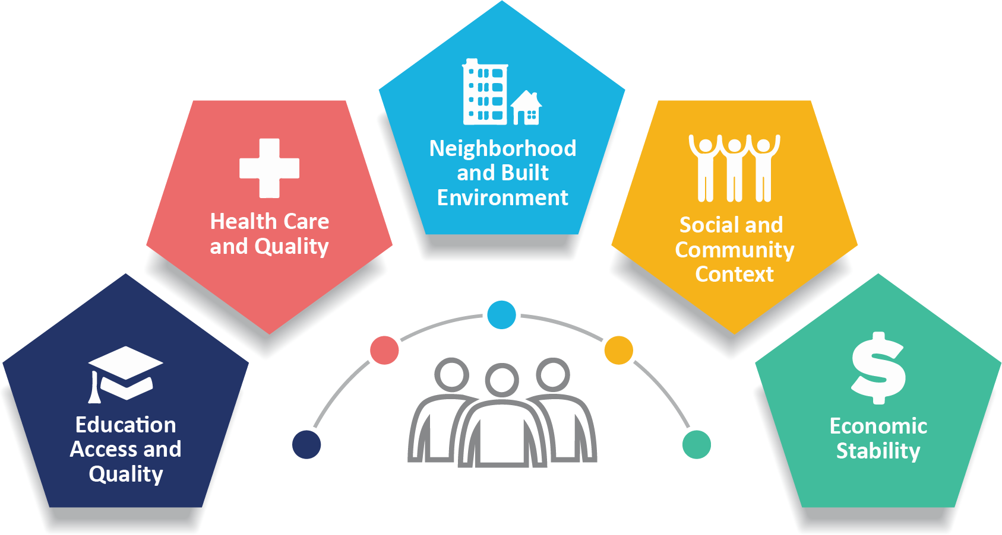
SDOH Pre-work Webinar Objectives
By the end of today’s event, teams should be able to:
Recognize the importance of addressing SDOH and identify the Collaborative aim.
Be able to state and complete Pre-work tasks, seeking support when needed.
Identify and plan to use key Collaborative materials such as the Change Package, Pre-work Handbook and Measurement Strategy.
Ask questions about the SDOH Collaborative.
Notes:
Learning Collaboratives (nj.gov)

Slide 3
DOH Leadership
Kaitlan Baston
Commissioner
Office of the Commissioner
Thalia Sirjue
Chief of Staff
Health Systems, Office of the Commissioner
Jeff Brown
Deputy Commissioner
Health Systems, Office of the Commissioner
Noah Glyn
Executive Director
Office of Health Care Financing
Christina Cartisano
Analyst
Office of Health Care Financing

Slide 4
Welcome and Introductions
Program Sponsor
Emma Trucks, MPH
Grace Mecha
Dak Ojuka
GraceAnn Friederick
Christina Southey
Collaborative Director
Collaborative Coordinator
Collaborative Coordinator
Collaborative Coordinator
Improvement Advisor

Slide 5
Quality Improvement Program – New Jersey DOH Sponsored Medicaid Managed Care Pay for Performance Program Background
QIP-NJ Medicaid Funding (State based with federal match)
QIP-NJ Medicaid Funding (State based with federal match)
BHLC
September 2021-September 2022
BH (70%)
Maternal Health (30%)
BH (70%)
Maternal Health (30%)
MLC
October 2022 - December 2023
improvements in maternal care processes​;
reductions in maternal morbidity​;
improvements in connections to behavioral health services; and ​
reductions in potentially preventable utilization for the BH population
improvements in maternal care processes​;
reductions in maternal morbidity​;
improvements in connections to behavioral health services; and ​
reductions in potentially preventable utilization for the BH population
Use of a Standardized Screening Tool for Social Determinants of Health
Use of a Standardized Screening Tool for Social Determinants of Health
SDOH Focused Collaborative!
SDOH Focused Collaborative!
SDOH Focused Collaborative!

Slide 6
SDOH LC Aim
By February 2025, NJ acute care hospitals participating in QIP-NJ will ensure that at least 50% of patients with an identified social need subsequently initiated services to address that need within 30 days of discharge, ensuring that patients received a trauma-informed and culturally humble care experience at all stages of care. Hospitals will achieve this by implementing best practices in the following drivers:
Hospitals will choose to focus their efforts on at least one of the following domains:
Housing Supports
Meal Supports
Transportation Supports

Slide 7
SDOHLC Domains
Housing Supports
Meal Supports
Transportation Supports
Connections to either permanent, transitional or emergency housing services
Warm handoffs: establishing connections for patients with Continuum of Care (CoC) housing agencies who have capacity.
Note that each agency has their own eligibility criteria.
Connections made to medically supported meals, healthy meal delivery and food benefits like SNAP and WIC and identifying additional community-based resources for ineligible patients.
Providing emergency meals and vouchers to patients and families, in addition to connecting patients to long term support through programs like SNAP / WIC.
Connections made to taxi/Uber/Lyft vouchers in addition to wheelchair, ambulance etc.
Arranged for all scheduled or planned appointments.
Clear instructions in the patient’s preferred language on using public transportation.

Slide 8
Which SDOH practices does your team need the most support for improvement in an SDOH-focused collaborative? (select all that apply)
Engaging and building strategic relationships with community partners | 77%
Developing Protocols | 48%
Training Staff | 43%
Leveraging technology | 30%
Other (please specify): | 7%
What Participants Want
Strategic Partnerships with Community Partners for:
Housing Supports
Meal Supports
Transportation Supports

Slide 9
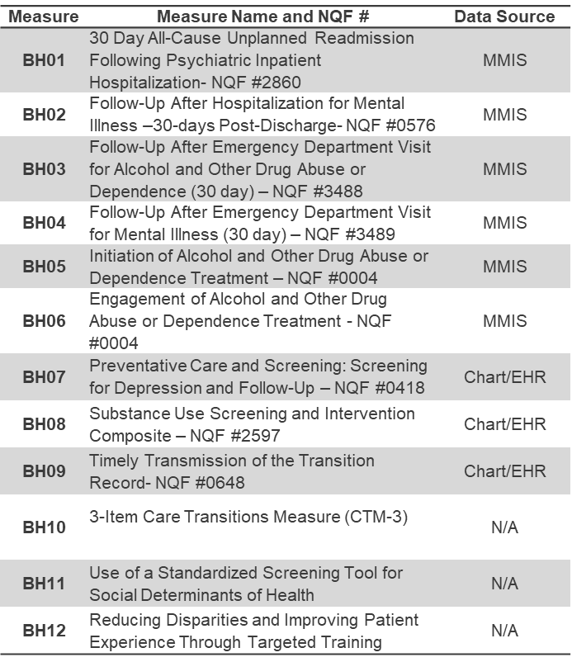
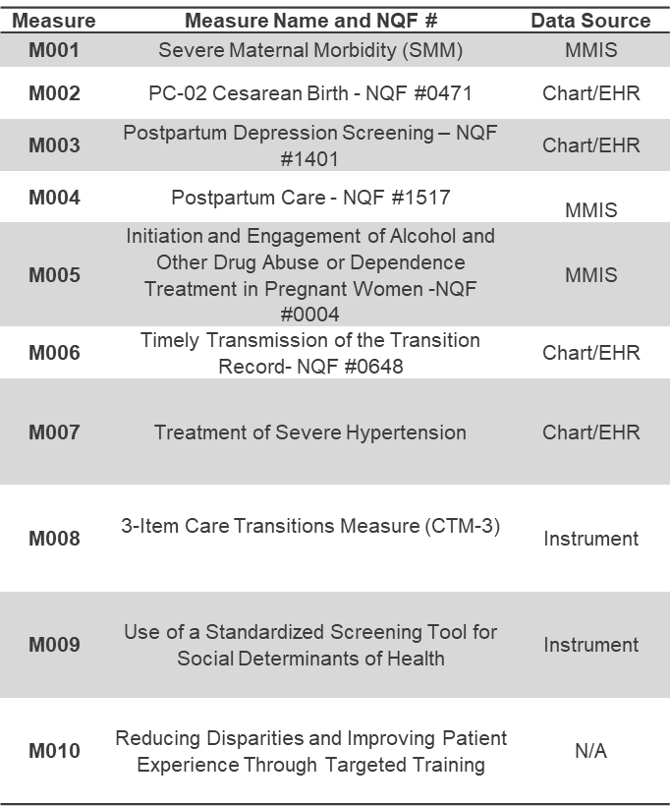
SDOH is a driver of many QIP-NJ P4P measure outcomes
SDOH
Equity in Outcomes and Experience
Screening and Referral Processes
Readmissions / Connections to Care after ED or Inpatient

Slide 10
The Need to Address SDOH in QIP-NJ and Beyond
SDOH Screening and Connection to Services
1 of 9 action areas in Nurture NJ Strategic Plan
CMS Merit-based Incentive Payment System (MIPS)– Screening for social drivers of health
1 of 5 overarching goals in CDC’s Healthy People 2030²
A 2016 study from Journal of Preventive Medicine estimates social and environmental factors contribute to 50% of health outcomes.
QIP-NJ pay-for-reporting aggregated MY2 outcomes show an opportunity to improve screening for attributed patients in OP and ED settings:
BH11: less than 20%
M009: just over 30%

Slide 11
SDOH Participation Expectations for Success
Success
Form an interprofessional team that meets regularly.
Complete pre-work team assessment.
Test practice changes outlined in the Change Package.
Attend 2 Learning Sessions (half-day virtual events).*
Attend monthly coaching sessions (60-minute webinar).*
Collect and report data on SDOH measures each month.
*CEUs / CMEs: Content for this course has been submitted to Rutgers UBHC, Rutgers RBHS for review for continuing education credits for New Jersey Social Workers, Psychologists, Professional Counselors, Licensed Clinical Alcohol and Drug Counselors, Marriage and Family Therapists, Physicians and Nursing. This statement is not an indication of approval or pending approval. Please refer all questions to Rutgers UBHC Center for Continuing Education: CCE@ubhc.rutgers.edu.

Slide 12
Collaborative Design

Slide 13
Our Collaborative Focus

Slide 14
Key Driver Diagram
Primary Drivers | Secondary Drivers
Patient Experience | Customize SDOH survey questions and communication to align with the needs, literacy levels, language and preferences of the target population. (Berry)
 | Incorporate feedback from those at every part of care process (i.e. social workers, patient navigators, etc) and patient experience data into care processes. (Bachman)
Leveraging Technology and Data-Tracking Systems | Establish a data-tracking system to monitor the entire screening-to-service process to identify gaps and inefficiencies in workflows. (Berry)
 | Establish referral tracking capabilities to ensure follow-up and closure of identified social needs. (Berry)
 | Review data regularly to screen for any potential trends and patterns.
Establishing Referral Protocols with Networks of Strategic Partners | Develop partnerships with community organizations and service providers to facilitate referrals for social needs. (Bachman)
 | Create clear pathways and protocols for referring patients to appropriate resources and support services.
Staffing and Coordination | Ensure oversight of screening and referral process. (Bachman, Berry)
 | Train staff to execute screening with a trauma-informed and culturally humble approach and to follow established protocols/workflows.
 | Utilize Community Health Workers (CHWs), Peer Support Specialists, Doulas to support screening capacity, reach and success.
 | Ensure that the staff reflects the community they are working with.
Integrating Universal Screening into Clinical Workflows | Distribute screening materials to patients upon registration, making it a standard part of the intake process.
 | Incorporate screening into routine surveys or assessments administered during clinic visits to streamline implementation and avoid low screening rates.
 | Develop next steps for addressing screening results that require further action, including follow-up assessments and referrals.

Slide 15
Change Package
A collection of actionable change ideas and resources that will help teams achieve the Collaborative aim.
Informed by an interprofessional panel of experts, representing state and national experts and people with lived experience addressing Social Determinants of Health, connections to care and health equity.

Slide 16
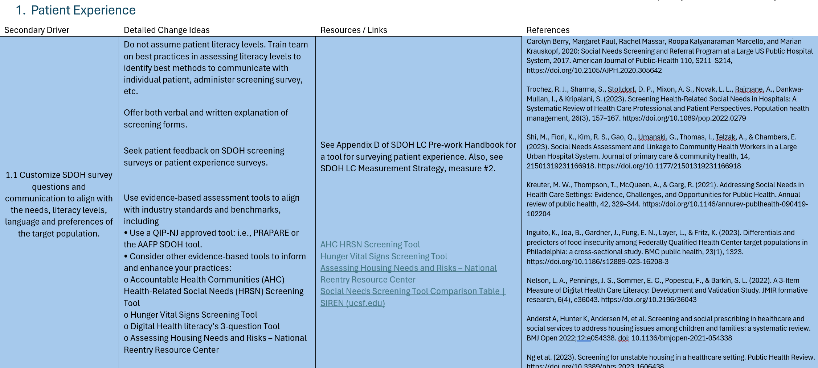
01
02
03
Detailed Change Ideas
Resources
References
Specific activities your team should consider testing in practice.
Links to tools and resources related to detailed change ideas.
Sources that lend confidence to change ideas.

Slide 17
Chat Waterfall
What work is already planned or underway in your hospital that aligns with the SDOH driver diagram and/or change package?
Instituting a mobile market on wheels for underserved populations
Launching the use of UniteUs & FindHelp in clinical workflows
Patient self-screening for SDOH upon e-check-in
Meeting patients where they are with literacy and language
Assessing internal data tracking for IP SDOH screenings
Working with community partners on data collection
Using Ride Health as a transportation support
Supplying vouchers for food
Using SDOH as a part of care planning
Designed team member (social worker) that handles connections to care

Slide 18
Pre-Work Handbook: Getting Started in the SDOH Collaborative
Forming a team & holding a kick-off meeting
Completing a Systems Review
Interviewing stakeholders to identify strengths and opportunities
Create your LS1 Storyboard

Slide 19
Forming a Team
Pre-work Handbook Appendix A and C
Team member roles | Time commitment
Executive Leader | 2-3 hours/month
Project Leader | 1-2 day(s)/month
Clinical Leads | 5-6 hours/month
Measurement Lead / IT analyst | Variable
Clinical & Staff representatives | 4-5 hours/month
Community provider/organization representatives | 4-5 hours/month
Patient and chosen family representatives | 2-3 hours/month
Understanding of SDOH LC
Hold a team kickoff meeting
Clear role definition
Prioritize communication
Please note: an individual team member can have multiple team member roles.
Clear role definition
Prioritize communication

Slide 20
Completing a
Systems Review
Pre-work Handbook Appendix B
What are the demographics of your patient population?
What is currently underway in your system that aligns with the domains?
How are you planning to communicate this work with those inside and outside your team?

Slide 21
Stakeholder Interviews:
Staff Members
Prework Handbook Appendix D
Interview guide for conversations with 3-5 staff members
Focus on identifying areas of strength and opportunity
First step in engaging beyond the core team
CHAT: What is a strength of, or what works well in, your hospital’s current SDOH screening and referral protocols that you are excited to share?

Slide 22
Stakeholder Interviews:
Staff Members
Chat Waterfall: What is a strength of, or what works well in, your hospital’s current SDOH screening and referral protocols that you are excited to share?
Documentation of SDOH in EPIC/EHR
Use of AAFP screening tool to make referrals in real time
Being able to understand and implement innovations around patient needs based on data
Ambulatory practice sites have high rates of SDOH screening completion
Discovering food insecurity as a problem within community
Using Community Connection, Find Health, etc to make referrals
Staff addresses patients’ unique needs
Maintaining a list of community resources that address HRSN; updated weekly

Slide 23
Stakeholder Interviews:
Patients and/or chosen family representatives
Interview guide for conversations with 3-5 patients
Focused on identifying areas of strength and opportunity
First step in redesigning with “context experts”

Slide 24
Core Collaborative Measures
Quantitative Measures | Completion Rate for Follow-Up Services after SDOH screening
 | Patient Experience
Qualitative Measures | Establish Relationship with Community Organization who Provides Most Needed Services
 | SDOH Training for Staff
Measurement Strategy is not meant to be exhaustive (only 4 Core Measures)
Measures were vetted with our expert panelists and pilot tested with two hospital groups
Quantitative Measures - numerical collection
Qualitative Measures - narrative / milestone-based collection

Slide 25
Core Collaborative Measures
1. Completion Rate for Follow-Up Services After SDOH Screening
Measure Definition
Suggested Data Collection Strategies
Denominator: Number of patients who had an identified social need from a (positive) screening, who accepted help, and were subsequently referred to the appropriate services.
Numerator: Number of referred patients who attended scheduled follow up appointments or began receiving services after an SDOH screening identified social needs within 30 days of discharge from the ED or in-patient settings (general and/or OB).
Allowable Exclusion - Patients who did not accept help with services… but learn why this is happening!
Step 1: Identify patients for denominator.
Option 1: Sample 20-30 patient charts from the EHR who meet the denominator criteria.
Option 2: Analyst produced roster of all patients screening positive with a referral.
Step 2: Identify a strategy to access numerator data.
Option 1: Partner with a Community Based Organization (CBO) to establish a feedback loop for gathering data.
Option 2: Implement a shared data platform to track population success towards the measure.
Option 3: Incorporate targeted questions into existing post-discharge patient outreach practices to collect patient reported outcomes.

Slide 26
Core Collaborative Measures
2. Patient Experience
Measure Definition
Suggested Data Collection Strategies
Teams will report the number of individuals they received patient experience feedback from. (so, no numerator and denominator, just the total who responded to your patient experience mechanism).
Teams should seek patient experience feedback from those who are screened for SDOH needs. Teams can learn unique and useful information from individuals representing each category:
Patient who accepted help.
Patient screened positive but did not accept help or referrals.
Patient who was referred to services.
Suggested Goal: 5 patients per month
Option 1: Asking a targeted set of patients who were screened from the denominator for Measure 1, who were referred to services (perhaps through established outreach phone calls)
Option 2: Organization (perhaps a CBO) who you’ve built a relationship with, asking patient experience questions.
Option 3: Survey
If Option 1-3 is not possible, use QIP-NJ BH10 / M008 “3-Item Care Transitions Measure (CTM-3). Be prepared to strategize with your team how you can use this data for real time targeted improvements in SDOH practices.

Slide 27
Optional Additional Collaborative Measures
Supplemental Measures | Use of a Standardized Screening Tool for Social Determinants of Health
 | 30- Day All-Cause Unplanned Readmission Following Psychiatric Inpatient Hospitalization
 | Follow-Up After Emergency Department (ED) Visit for Substance Use or Mental Illness (30-day)
 | Postpartum Care (PPC)
These QIP-NJ P4P measures are not required for reporting in the Collaborative but provide an opportunity for teams to track progress.
Benefits of tracking:
Aligning with P4P measure improvement
Identifying areas of success to help gain leadership buy-in, define ROI
Making targeted interventions where necessary

Slide 28
SDOHLC Tasks and Relationship Building Roadmap
Identify and Develop Relationship with Community Providers. Consider the services they provide relative to SDOHLC aim and inclusive treatment standards
Consider eligibility for services with this provider and how that might impact your team’s approach to data collection and denominator criteria in the SDOH LC
Convene Regular Meetings with Key Staff / Contacts
Shared Goal Setting
Establish Workflows for Referral and Service Initiation
Testing and Tracking Progress Through Data
MOU/BAA
Data Sharing Agreements
July 2024
Aug 2024
Sept 2024
Oct 2024
Nov 2024
Dec 2024
Jan 2025
Feb 2025
*Adapted from Oaks Integrated Care “Building Effective Relationships with Community Partners- Key Steps From the Field” presentation from the QIP-NJ Behavioral Health Learning Collaborative in 2021 (Session Recording Available for SDOH LC Participants Upon Request).
Pre-work Tasks:
Form a Team
Hold First Team Meeting (Pre-work Handbook Appendix C)
Begin to identify the domain(s) your team will focus on and identify potential community partners
Perform System Review (Pre-work Handbook Appendix B)
7/31 Attend Data Collection and Measurement Strategy Guidance Webinar
Pre-work Tasks:
Collect Baseline Data (See Measurement Strategy)
Conduct stakeholder experience interviews (Pre-work Handbook Appendix D)
Review and plan Change Package strategies with team
Learning Session 1!
Pre-work Tasks:
Register team members for Learning Session 1 (LS1)
Complete and submit Storyboard for LS1
Conduct stakeholder interviews (Pre-work Handbook Appendix D)
Submit Baseline Data
Tasks:
Submit monthly data
PDSA cycles on Change Package strategies
Milestones:
Reach out to CBO partner(s) to establish relationship
Identify key CBO contacts, schedule initial meeting, define roles
Establish shared vision and goals with CBO
Tasks:
Submit monthly data
PDSA cycles on Change Package strategies
Milestones:
Establish and test Referral Workflows with CBO
Consider sustainable data tracking methods with CBO partner
Learning Session 2!
Tasks:
Submit monthly data
PDSA cycles on Change Package strategies
Milestones:
Improve Referral Workflows with CBO with eye towards sustainability
Consistent communication and meetings with CBO partner
Tasks:
Submit monthly data
PDSA cycles on Change Package strategies
Milestones:
Improve Referral Workflows with CBO with eye towards sustainability
Consistent communication and meetings with CBO partner
Begin plan for data sharing agreement or MOU
Tasks:
Participate in final outcomes event
Milestones:
Ensure and further plan for sustainability of progress!

Slide 29
What’s Next?
Baseline data - collected during pre-work period in summer
PCG currently developing monthly data collection and submission forms and support tools.
Data collection form is forthcoming will be circulated in the coming weeks with additional guidance.
More Support!
PCG will host a webinar to provide guidance on baseline data collection and the measurement strategy on July 31st 12:00 – 1:00 ET.
Enter in chat OR come off mute: Based on this conversation, what are your biggest concerns with data collection?

Slide 30
Upcoming Events: Monthly Coaching Calls
First OR Last Wednesday of the Month
12 PM to 1 PM EST

Slide 31
Upcoming Events: Learning Session 1
Upcoming Events: Learning Session 1
September 25th OR 26th
10 AM to 1 PM EST

Slide 32
Learning Session 1
Story Boards
Based on learnings from pre-work activities
Brief 10-minute presentations in breakout groups
PPT Template for storyboard will be posted in July
All teach, all learn
Storyboards will be due in mid-September

Slide 33
Our Work This Summer
Supporting Teams
Recruiting Local Faculty & CBOs to Support Coaching
Issuing Guidance on Data Collection and Visualization
Launching Participant Portal
Planning Agenda for Learning Session 1!

Slide 34
Participant Portal – Issuing Accounts
Last reminder about PIF due today
Contact us at QIP-NJ@pcgus.com for an extension
Account generated in about 2 weeks.
All materials will be posted:
Storyboard templates
Session recordings and slides
Collaborative Materials, Data Visualizations and Resources
Contact information for Participating Teams

Slide 35
POLL
Do you feel you need additional assistance with the pre-work?
Please enter your contact information for us to reach you.

Slide 36
THANK YOU
Questions?
Schedule a one-on-one with us to go over any questions.
Send questions, comments or requests for additional support in this process to qip-nj@pcgus.com.
https://qip-nj.nj.gov/Home/LC

