Slide 1
Social Determinants of Health (SDOH): Increasing connections to services Presented by the NJ Department of Health (DOH) in partnership with Public Consulting Group (PCG)
Information Session
May 22nd, 2024
12:00 PM - 1:00 PM ET

Slide 2
DOH Leadership
Kaitlan Baston
Commissioner
Office of the Commissioner
Thalia Sirjue
Chief of Staff
Health Systems, Office of the Commissioner
Jeff Brown
Deputy Commissioner
Health Systems, Office of the Commissioner
Noah Glyn
Executive Director
Office of Health Care Financing
Christina Cartisano
Analyst
Office of Health Care Financing

Slide 3
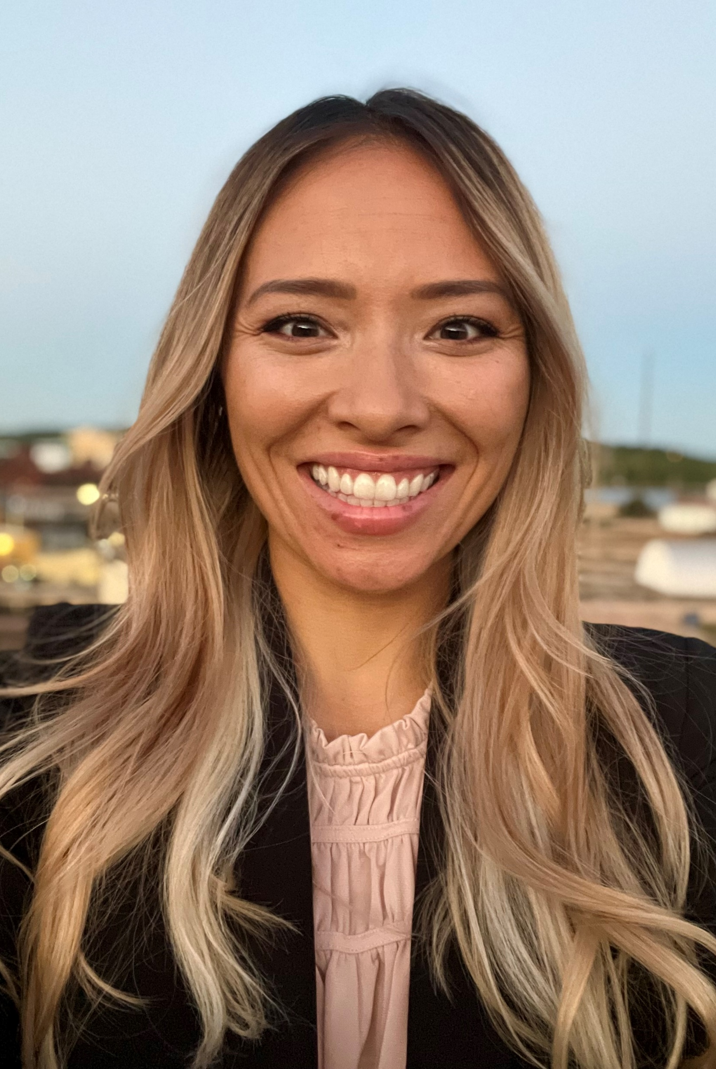
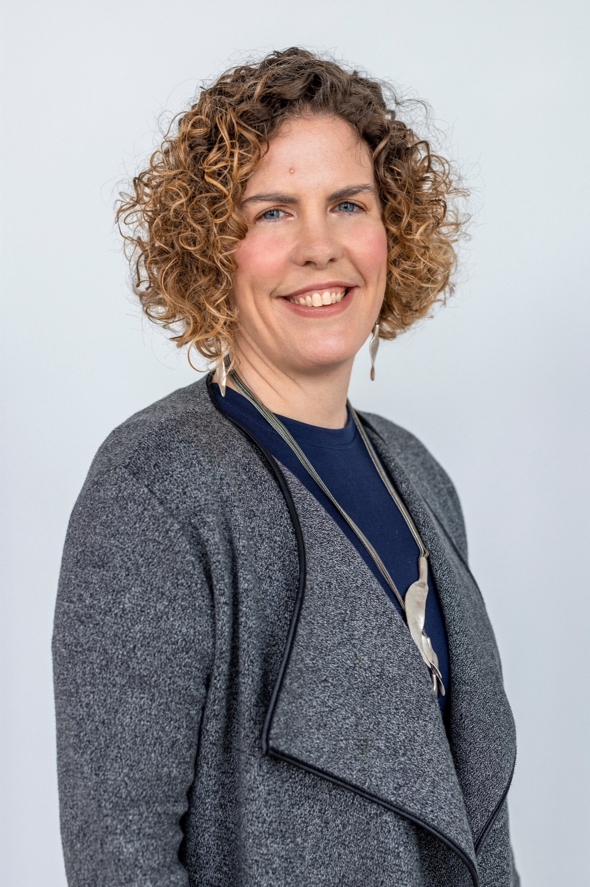
Welcome and Introductions!
Program Sponsor
Emma Trucks, MPH Collaborative Director | Grace Mecha Collaborative Coordinator | Dak Ojuka Collaborative Coordinator | GraceAnn Friederick, MBA Collaborative Coordinator | Christina Southey, MSc Improvement Advisor
Notes:
Emma Trucks is the Collaborative Director. She brings over 12 years of experience working in healthcare quality improvement as a manager, advisor, and educator, with over five years at Public Consulting Group. Ms. Trucks is a high performing manager of programs, projects and people and is an experienced consultant addressing gaps in clinical quality and performance using data-driven methods. She serves as the senior program manager for the Quality Improvement Program – New Jersey (QIP-NJ) project and has led 2 full learning collaboratives that support performance in the P4P program. She is also the senior advisor for the California-based PATH Collaborative Planning and Implementation (CPI) Initiative, supporting the execution of the program’s statewide collaboratives focused on delivery system reform.
Grace Mecha is the Collaborative Program Evaluation Coordinator. She brings experience across the healthcare sector as a program facilitator, communications manager, and policy & data analyst. At Public Consulting Group, Ms. Mecha’s focuses on project management, collaboration facilitation, data analysis & evaluation, and technical assistance to support quality improvement initiatives for Medicaid managed care populations. She is a key member in both the QIP-NJ P4P program as a data, policy, and communications analyst and as a coordinator learning collaboratives that support the project. She completed the Institute of Healthcare Improvement’s Breakthrough Series College in 2023, deepening her subject matter expertise in quality improvement and ability to apply improvement science in healthcare settings.
Dak Ojuka is the Collaborative Data Coordinator. Mr. Ojuka, a consultant at Public Consulting Group, is an experienced data and policy analyst with focuses Medicaid redesign initiatives, promoting health equity, and addressing social determinants of health. Having earned a degree in Biology and Business studies from Providence College. Mr. Ojuka plays a key role in managing the data analytics and visualization workstreams of QIP-NJ learning collaboratives, while also serving a key role in supporting the technical aspects of the program to support data-driven decision making. Mr. Ojuka serves as a project coordinator for the PATH CPI Initiative. His role includes managing communications, maintaining client relationships, and overseeing the internal data intake process. Mr. Ojuka also assists with data cleaning, analysis and process standardization efforts on the Massachusetts DSRIP Independent Assessor Project.
Ms. GraceAnn Friederick is a Collaborative Administrative Coordinator. She is a business analyst at Public Consulting Group since August 2023. Ms. Friederick earned her master’s degree in business administration in healthcare management from Capella University of in 2021 and has attended the Breakthrough Series College with the Institute of Healthcare Improvement (IHI) for quality improvement collaborative work. Ms. Friederick provides high-level work integrating various elements of quality improvement work: process workflows, data visualization and interpretation, healthcare consultation, and system administration.
Christina Southey is the Improvement Advisor of the collaborative. She is an experienced Improvement Advisor and collaborative facilitator from the Institute of Healthcare Improvement who supports improvement projects in the US and Canada. She has supported numerous Breakthrough Series Collaboratives across multiple topics. She teaches improvement skills to professionals in small and large group settings in north America and internationally.

Slide 4
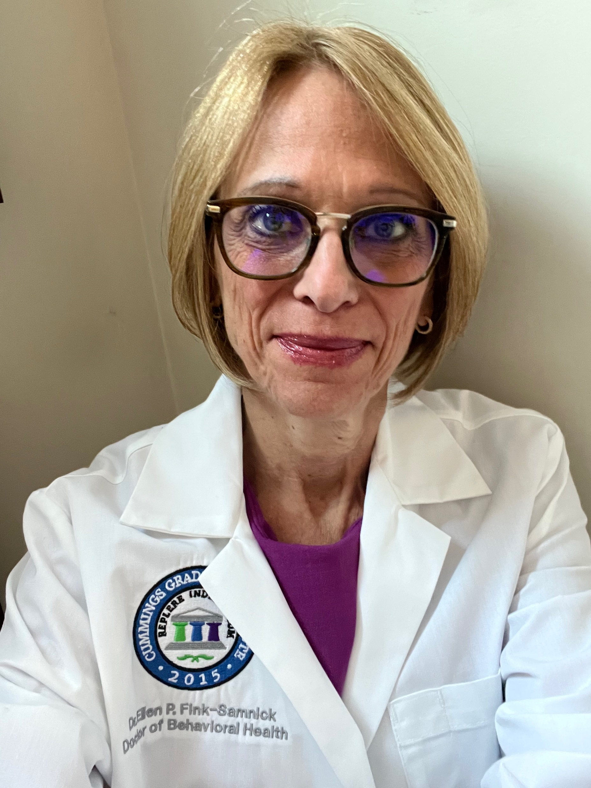
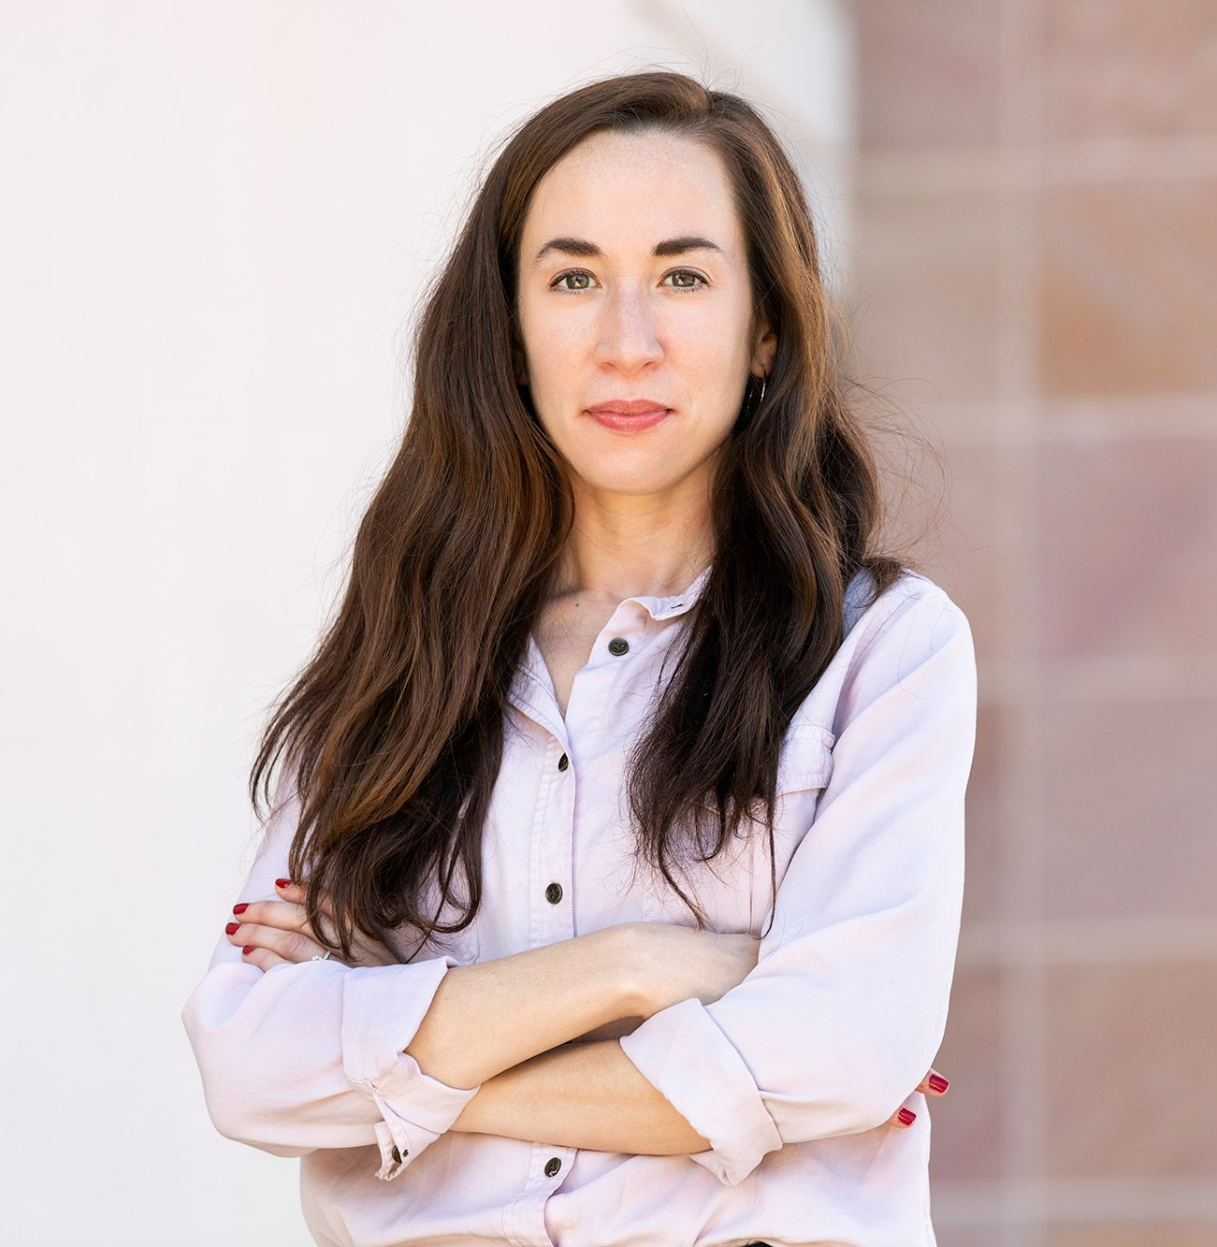
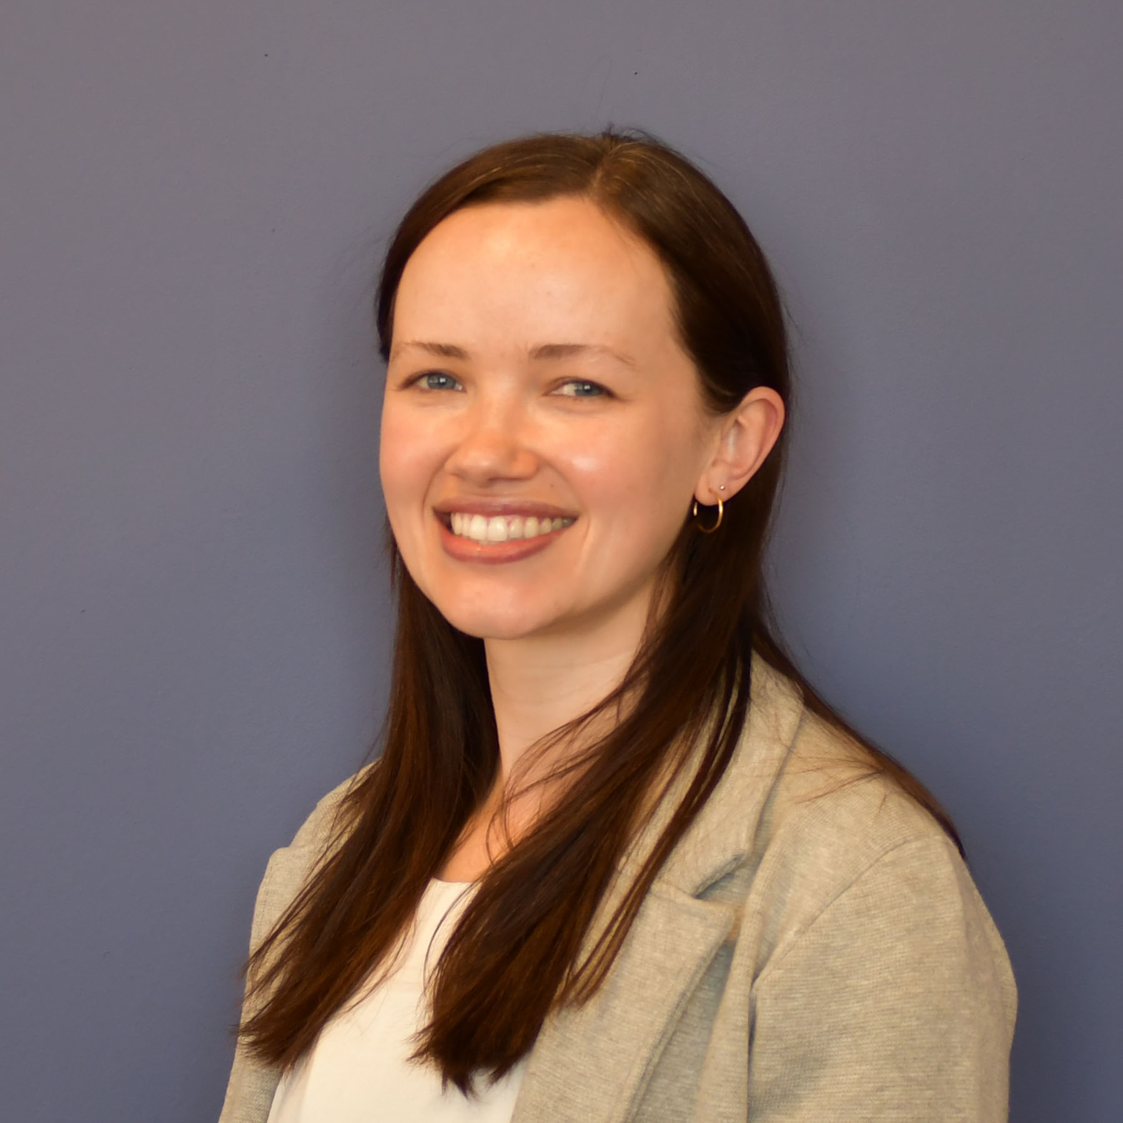
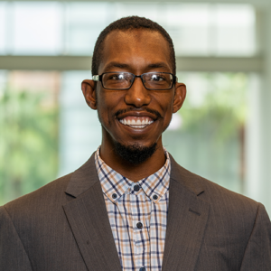
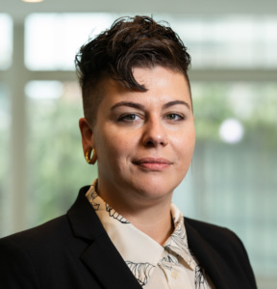
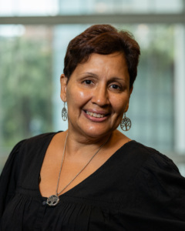
SDOH Advisors and Planners Engaged to Date
Jenny Bernard Hackensack Meridian Health System | Ellen Fink-Samnick EFS Supervision Strategies, LLC | Katherine Marcal Rutgers University School of Social Work | Raquel Mazon Jeffers US Initiatives at Community Health Acceleration Partnership | Leigh Wilson-Hall, MSW Camden Coalition of Healthcare Providers
Jamal Brown Amplify, a consumer speaker’s bureau | Ren Pelley Amplify, a consumer speaker’s bureau | Aracelis Quinones Amplify, a consumer speaker’s bureau
Notes:
EMMA
1. Dr. Bernard is the founder of The First Thirty Program, a transitions-of-care program that provides equitable care to underserved populations across ten acute care hospitals. She led the DSRIP project and is currently the director for QIP-NJ across all HMH sites of care. She is an advanced practice nurse with experience in in-patient transitions of care, hospice home care, adult/geriatric, and urgent care. She has led multiple quality improvement projects working with uninsured or underinsured populations with chronic conditions. She earned her BSN/MSN from Rutgers University and her doctoral degree from Monmouth University. She is medical-surgical certified and has received various awards.
2. Dr. Ellen Fink-Samnick is an award-winning industry entrepreneur who empowers healthcare's interprofessional workforce. She is a subject matter expert on Ethics, Health Equity, Integrated Care, Interprofessional Teams, Professional Case Management, Quality, and Trauma-informed Leadership. Dr. Fink-Samnick is the author of 5 books for professional case managers, including her recent publication The Ethical Case Manager: Tools and Tactics. Her 6th title, Behavioral Health for Case Management, will be published by Blue Bayou press and released in Fall 2024. She is also editing her first book, Integrated Behavioral Health: Applying the Biodyne Model in Healthcare, which will be published by Routledge in Winter of 2025.
Dr. Fink-Samnick has a Doctorate in Behavioral Health with specialization in Health Equity, Integrated Care, Quality, Leadership, and Trauma-Informed Practice. She is a Licensed Clinical Social Worker, Board-certified Case Manager, and Certified Clinical Trauma Professional. Dr. Fink-Samnick has been named as a Fellow in Case Management by the Case Management Society of America, a Fellow for RISE Association, and as a member of the academic honor society, Delta Epsilon Tau.
Dr. Fink-Samnick serves the industry through assorted roles with academic appointments at Cummings Graduate Institute of Behavioral Health Studies and George Mason University’s College of Public Health. She also teaches the ethics curriculum for Case Management University. Dr. Fink-Samnick is moderator of Ellen’s Ethical Lens on LinkedIn and author of the blog, Ellen’s Interprofessional Insights. She is a consultant for the Case Management Institute and a moderator for their Case Managers Community. Dr. Fink-Samnick is Editor of the Heartbeat of Case Management Column for Wolters Kluwer’s Professional Case Management Journal, and member of the journal’s editorial advisory board. Dr. Fink-Samnick is also a clinical social work supervision instructor for the National Association of Social Workers of Virginia and Metro DC.
​
Dr. Fink-Samnick is known for her fierce professional voice. Along with leadership and committee roles across credentialing entities and professional associations, she has shared her expertise with the Gravity Project, the National Coalition for Social Work and Health, and RISE Association. She is the current Vice-Chair of CMSA’s Diversity, Equity, Inclusion, and Belonging Core Committee. Further information is available on her LinkedIn Profile.
3. Katherine Marçal is an Assistant Professor in the School of Social Work at Rutgers University and a member of the Child Well-Being Research Network. She received her bachelors, masters, and doctorate degrees from Washington University in St. Louis. Dr. Marçal’s areas of expertise include housing insecurity and homelessness among families with children, maternal and child mental health, and community-based system dynamics.
Dr. Marçal’s research has been funded by local, state, and federal agencies including the Doris Duke Charitable Foundation, the National Institutes for Health (NIH), the U.S. Department of Housing and Urban Development (HUD), and the National Oceanic and Atmospheric Administration (NOAA). Her work has been published in prominent scholarly journals across disciplines including Annual Review of Public Health, Psychiatry Research, American Journal of Community Psychology, Child Abuse & Neglect, and Journal of Interpersonal Violence among others.
Dr. Marçal actively collaborates with community agencies and policymakers toward ending homelessness, increasing affordable housing, and meeting needs of vulnerable families with children.
4. Raquel Mazon Jeffers co-directs The Community Health Acceleration Partnership (CHAP), where she provides strategic guidance to the principal investors on modernizing the public health system.
Ms. Mazon Jeffers brings many years of experience leading transformative public health initiatives. She’s impacted health and behavioral health systems on behalf of Government agencies, foundations and non-profits. Much of her work has focused on delivery system reform for vulnerable populations.
Before joining CHAP, Ms. Mazon Jeffers was a Senior Program Officer at The Nicholson Foundation, where she led grantmaking on population health, telehealth, and maternal and child health. The initiatives she launched included the Colette LaMothe-Galette Community Health Worker Institute, the Doula Learning Collaborative, and a New Jersey Telehealth hub.
Prior to Nicholson, Ms. Mazon Jeffers served as Deputy Director of the Division of Mental Health and Addiction Services for the New Jersey Department of Human Services. In this role, she modernized New Jersey’s addition system of care, involving 300 agencies, increasing access and integrating behavioral health and primary care services.
Ms. Mazon Jeffers also served as Director of Managed Care for a large network of Federally Qualified Health Centers. In addition to her state-level work, she’s influenced health policy for the City of Trenton. On behalf of The Ford Foundation, she facilitated the formation of the first grassroots women-of-color health advocacy organization which is now at the forefront of the birth-equity movement.
Ms. Mazon Jeffers holds two Master’s degrees, one in Public Health and the other in International Affairs.
5. Leigh Wilson-Hall, MSW serves as the Director of Care Management and Redesign Initiatives. In this role she oversees an interdisciplinary team that works with regional partners to pilot and implement programming to support patients with complex health and social needs. This includes the Camden Coalition’s patient-facing care management initiatives, the Medical Legal Partnership and the clinical redesign team. Leigh previously oversaw the clinical redesign team with a focus on behavioral health, maternal and child health and harm reduction initiatives. Prior to joining the Coalition, Leigh was with the Children’s Hospital of Philadelphia, where she worked closely with clinical teams to design and measure community-oriented interventions. Leigh holds a Master of Social Work from the University of Pennsylvania.
6. Jamal Brown is an inspirational community member, father, coach, and mentor who strives to set a good example for the next generation. He was inspired to do this work because he knows what it is like not to have the type of encouragement he now gives to others. Jamal is an active member of Camden Coalition’s Community Advisory Committee and Housing First group, an alumni of the National Consumer Scholar program, and a Camden County NuEntry Opportunity Specialist where he helps people who are leaving incarceration to integrate back into society and not feel alone. In 2019 he shared testimony at the New Jersey State House of Representatives to support passage of a bill to improve access to state IDs and driver’s licenses. In his free time, Jamal enjoys playing video games, reading the Bible, and spending time with positive people.
7. Ren Pelley, CRSP (she/they) is a Certified Recovery Support Practitioner who works across Southern New Jersey as a Peer Support Specialist and Expressive Arts Facilitator. They use their lived experience with their LGBTQ+ identity, neurodiversity, chronic pain, and mental health recovery not only to support their peers who are facing challenges, but to consult other peer providers in enrichment activities that embody the quote “see what’s strong, not what’s wrong.” Ren was inspired to become a peer specialist during their own time in a mental health outpatient program. They had never met a peer specialist, and for the first time since hospitalization they finally felt “seen,” and found a sense of purpose in bringing that same hope to others. Ren received their diploma as an adult at the Goodwill Industries Helms Academy, received their credentials through the NJ Mental Health Association, and has trained for a year learning recovery-based cognitive therapy for peer providers with the Rutgers and Beck Institute’s CT-R program. They are currently pursuing further education in psychiatric rehabilitation.
8. Aracelis Quinones is the Coordinator of Poder Latino (Latino Power), a group for people living with HIV/AIDS, and a woman living with HIV for the past 34 years. She is passionate about her work with underserved and Spanish-speaking HIV+ communities. After moving from Puerto Rico to New York, she started working in the social services field with the Coalition for Hispanic Family Services in Brooklyn where she assisted facilitating an HIV positive women’s group and advocated for clients’ rights. Aside from her work as a coordinator with Poder Latino, one of the longest-lived HIV education and support programs with Latinos in the U.S, since 1998 she has worked with the Latino Commission on AIDS, advocating and fighting HIV stigma. In her spare time, she loves to spend time with family and friends, cooking, doing research on the internet, and giving a hand to those in need, especially women living with HIV.

Slide 5
Your hospital is invited to participate in the QIP-NJ SDOH Learning Collaborative!
Today’s Agenda
Provide an overview of the Learning Collaborative framework.
Review the SDOH Needs Assessment Results.
Review Collaborative design and benefits for participation.
Provide information on how to join.
Notes:
SDOHLC Infographic:
https://qip-nj.nj.gov/Documents/QIP-NJ_SDOH_Infographic.pdf

Slide 6
POLL 1
Which best describes your current status?
Already joined SDOH LC, and here to learn more!
Intending to join, still need to turn in Participation Interest Form.
Not sure whether to join, need more information.
Unlikely to join.

Slide 7
POLL 2
Did you participate in any prior QIP-NJ Collaboratives?
Yes - Behavioral Health Learning Collaborative.
Yes – Maternal Learning Collaborative.
Both BHLC and MLC!
No.

Slide 8
Quality Improvement Program – New Jersey DOH Sponsored Medicaid Managed Care Pay for Performance Program Background
QIP-NJ Medicaid Funding (State based with federal match)
QIP-NJ Funding
BHLC
September 2021-September 2022
BH (70%)
Maternal Health (30%)
BH (70%)
Maternal Health (30%)
MLC
October 2022 - December 2023
improvements in maternal care processes​;
reductions in maternal morbidity​;
improvements in connections to behavioral health services; and ​
reductions in potentially preventable utilization for the BH population
Use of a Standardized Screening Tool for Social Determinants of Health
Maternal Learning Collaborative
SDOH Focused Collaborative!

Slide 9
QIP-NJ Behavioral Health Performance Measures
Measure # | Measure Type | Measure Name and NQF #
BH1 | MMIS (Claims) | 30 Day All-Cause Unplanned Readmission Following Psychiatric Inpatient Hospitalization- NQF #2860
BH2 | MMIS (Claims) | Follow-Up After Hospitalization for Mental Illness –30-days Post Discharge- NQF #0576
BH3 | MMIS (Claims) | Follow-Up After Emergency Department Visit for Alcohol and Other Drug Abuse or Dependence (30 day) – NQF #3488
BH4 | MMIS (Claims) | Follow-Up After Emergency Department Visit for Mental Illness (30 day)– NQF #3489
BH5 | MMIS (Claims) | Initiation of Alcohol and Other Drug Abuse or Dependence Treatment – NQF #0004
BH6 | MMIS (Claims) | Engagement of Alcohol and Other Drug Abuse or Dependence Treatment - NQF #0004
BH7 | MMIS (Claims) | Preventative Care and Screening: Screening for Depression and Follow-Up – NQF #0418
BH8 | MMIS (Claims) | Substance Use Screening and Intervention Composite – NQF #2597
BH9 | Chart/EHR | Timely Transmission of the Transition Record- NQF #0648
BH10 | Instrument | 3-Item Care Transitions Measure (CTM-3)
BH11 | Instrument | Use of a Standardized Screening Tool for Social Determinants of Health
BH12 |  | Reducing Disparities and Improving Patient Experience Through Targeted Training
NOTES: Measures BH10,11, 12 must be submitted by the hospital to receive funding, but performance on these measures will not drive payment.

Slide 10
QIP-NJ Maternal Health Performance Measures
Measure # | Measure Type | Measure Name and NQF #
M001 | MMIS (Claims) | Severe Maternal Morbidity (SMM)
M002 | Chart/EHR | PC-02 Cesarean Birth - NQF #0471
M003 | Chart/EHR | Postpartum Depression Screening – NQF #1401
M004 | MMIS (Claims) | Postpartum Care - NQF #1517
M005 | MMIS (Claims) | Initiation and Engagement of Alcohol and Other Drug Abuse or Dependence Treatment in Pregnant Women -NQF #0004
M006 | Chart/EHR | Timely Transmission of the Transition Record- NQF #0648
M007 | Chart/EHR | Treatment of Severe Hypertension
M008 | Instrument | 3-Item Care Transitions Measure (CTM-3)
M009 | Instrument | Use of a Standardized Screening Tool for Social Determinants of Health
M010 | Chart/EHR | Reducing Disparities and Improving Patient Experience Through Targeted Training
NOTES: Measures BH10,11, 12 must be submitted by the hospital to receive funding, but performance on these measures will not drive payment.

Slide 11
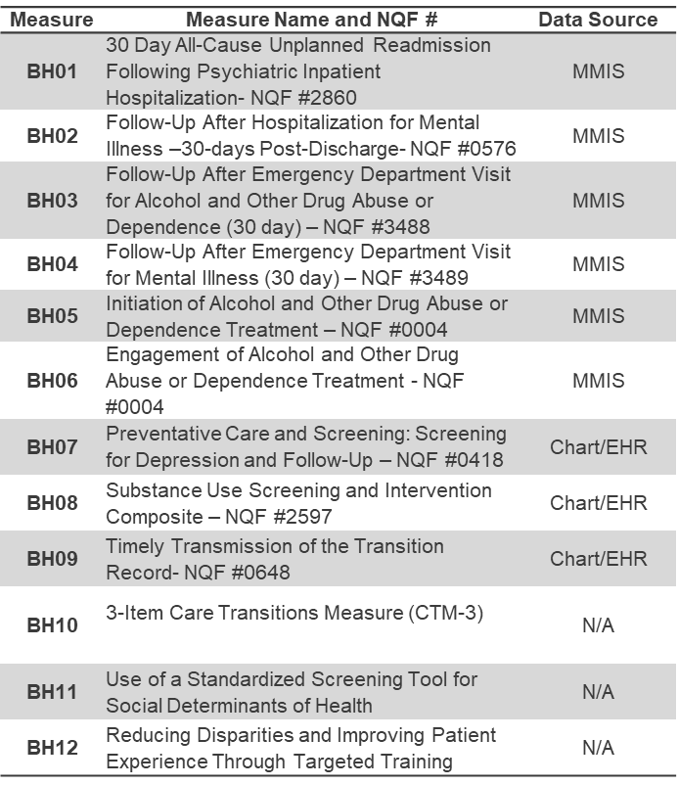
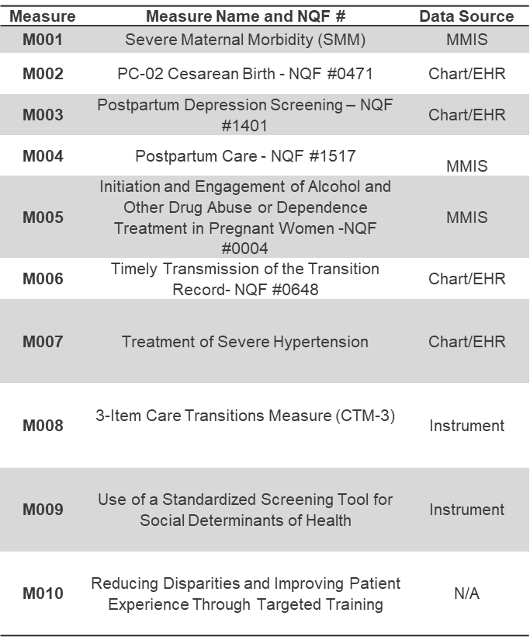
SDOH is a driver of many QIP-NJ P4P measure outcomes
SDOH
Equity in Outcomes and Experience
Screening and Referral Processes
Readmissions / Connections to Care after ED or Inpatient

Slide 12
A Patient Story
Ren Pelley, CRSP (she/they)
Areas of expertise: Peer Support, person-centered life planning, storytelling, writing, advocacy for Peer Specialists and organizations to counter co-optation of Peer Providers
Notes:
their story!

Slide 13
Needs Assessment Data

Slide 14
The Need to Address SDOH in QIP-NJ and Beyond
SDOH Screening and Connection to Services
1 of 9 action areas in Nurture NJ Strategic Plan
CMS Merit-based Incentive Payment System (MIPS)– Screening for social drivers of health
1 of 5 overarching goals in CDC’s Healthy People 2030²
A 2016 study from Journal of Preventive Medicine estimates social and environmental factors contribute to 50% of health outcomes.
QIP-NJ pay-for-reporting aggregated MY2 outcomes show an opportunity to improve screening for attributed patients in OP and ED settings:
^{BH11: less than 20%}
^{M009: just over 30%}

Slide 15
What Participants Want: Virtual Format, All Patients, Most Settings
39 Hospitals responded
46 individuals responded
Respondents consisted of Executive leaders, Nursing leadership, Quality and Patient Safety staff, Clinical services leaders and data management and operations leaders.
Learning Session Format | Population of Focus | Clinical Setting of Focus
Virtual 3-hour Sessions (Preferred by 78%) | Focus on Maternal & BH Populations (Preferred by 63%) | ED & Inpatient Settings (Preferred by 64%)

Slide 16
What Participants Want: Strategic Partnerships with Community Partners
Which SDOH practices does your team need the most support for improvement in an SDOH-focused collaborative? (select all that apply)
Engaging and building strategic relationships with community partners | 77%
Developing Protocols | 48%
Training Staff | 43%
Leveraging technology | 30%
Other (please specify): | 7%

Slide 17
What Participants Want: Variety of Domains with emphasis on Housing, DayHab, SUD Supports, Meals and Transportation
Domain | % Need Most Support | % Need Some Support
Housing Transition Navigation Services | 65% | 26%
Short-Term Post-Hospitalization Housing | 65% | 20%
Day Habilitation Programs | 57% | 26%
Sobering Center | 54% | 24%
Housing Deposits | 52% | 28%
Recuperative Care (Medical Respite) | 52% | 24%
Housing Tenancy and Sustaining Services | 50% | 33%
Medically-Supportive Food/Medically Tailored Meals | 11% | 80%
Transportation support for travel to medical services | 24% | 61%
Personal Care and Homemaker Services | 30% | 50%
Domestic Violence support | 37% | 41%
Community Transition Services/Nursing Facility Transition to a Home | 33% | 39%
Respite Services | 35% | 37%
Environmental Accessibility Adaptations (Home Modifications) | 22% | 35%
% Indicating the level of support teams need in each domain to better connect patients to services

Slide 18
SDOH Challenges Faced by Hospitals:
What is your greatest challenge when connecting patients to SDOH services and how could a collaborative help solve this challenge?
Communication Coordination with CHOs
Access and Eligibility
Housing and Additional Support
What is your greatest challenge or concern related to relationship building with community providers offering SDOH services and how could a collaborative help address this challenge?
Communication and coordination with CBOs
Waitlists, access and availability of providers
Eligibility, limited options for Medicaid covered pts
What barriers or challenges do you face when implementing and sustaining SDOH initiatives across your organization or in your department and what support do you need to address these challenges?
Staff time / capacity
Data sharing challenges
What type of training or resource does your facility most need to promote health equity related to SDOH?
Staff training
County Specific job aid of all available resources

Slide 19
Collaborative Design

Slide 20
Collaborative Design

Slide 21
SDOHLC Aim
By February 2025, NJ acute care hospitals participating in QIP-NJ will ensure that at least 50% of patients with an identified social need subsequently initiated services to address that need within 30 days of discharge, ensuring that patients received a trauma-informed and culturally humble care experience at all stages of care. Hospitals will achieve this by implementing best practices in the following drivers:
Hospitals will choose to focus their efforts on at least one of the following domains:
Housing Supports
Sobering Centers
Day Habilitation and Respite Services
Meal Supports
Transportation Supports

Slide 22
Collaborative Measurement Strategy The Approach
Align QIP-NJ P4P measures and additional SDOH measures
Expert panelist recommendations
Hospital team feasibility pilot test
Identify a SMALL set of measures, to accommodate timeline
Recommend tangible data collection and tracking strategies

Slide 23
Collaborative Measurement Strategy Measures Under Consideration
M009, BH11: Use of a standardized Screening Tool
% of patients with a positive screen who initiate SDOH services
Collaborative specific patient experience measure
Staff training milestone
CBO strategic relationship building milestone
BH03 and BH04: Follow-up after ED visit (30 day)
BH01: 30-day all cause unplanned readmissions

Slide 24
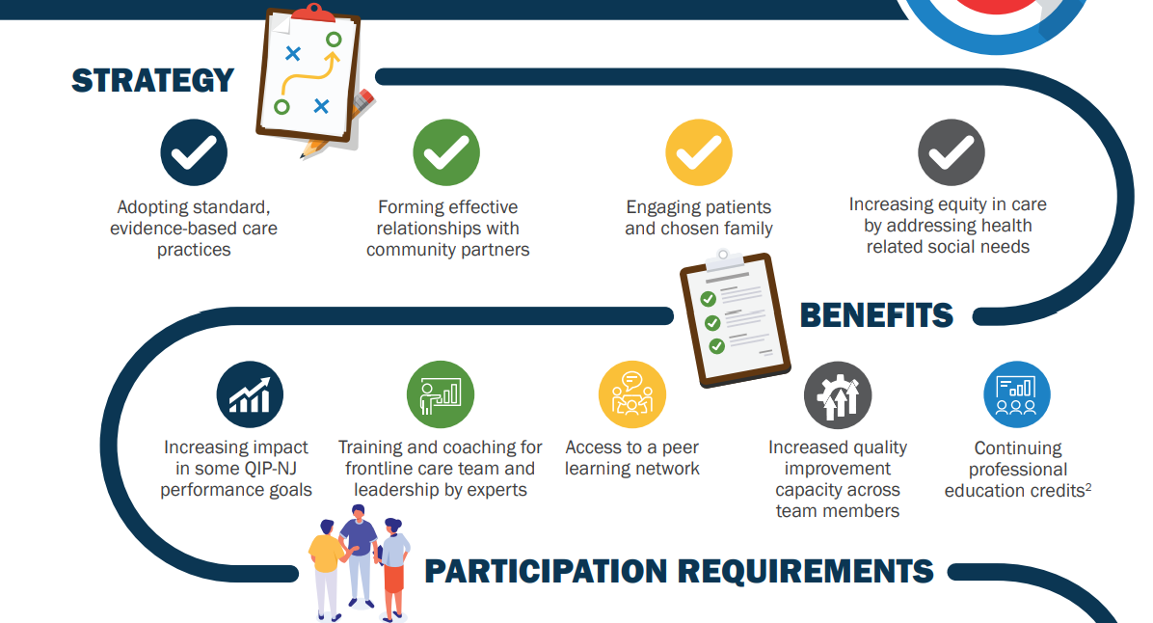
Participation
²Credits for physicians, nurses, social workers, pharmacists and psychology credits for psychologists or certified counselors.

Slide 25
SDOH Participation Expectations for Success
Success
Form an interprofessional team that meets regularly.
Complete pre-work team assessment.
Test practice changes outlined in the Change Package.
Attend 2 Learning Sessions (half-day virtual events).
Attend monthly coaching sessions (60-minute webinar).
Collect and report data on SDOH measures each month.

Slide 26
Tentative LC3 SDOH Collaborative Timeline 2024-2025
April 2024
May 2024
June 2024
July 2024
August 2024
September 2024
October 2024
November 2024
December 2024
January 2025
April/May 2024:
Expert Panelists Recruited
Expert Panel Sessions Scheduled/Held
June 2024:
Collaborative Kick-Off Pre-Work Support Call (Pre-work review and initial training)
Participant Recruitment Ends
September 2024
Learning Session 1
Dashboard launched with baseline data
December 2024:
Learning Session 2
May 2024:
Information Session Webinar Hosted
Participant Recruitment Begins
KDD, Change Package, Measurement Strategy Posted Online
July – September 2024:
Participants complete pre-work, identify strategic CBO partner, and submit baseline data
PCG offers 1:1 coaching to teams
PCG recruits speakers for and plans Learning Session 1 (i.e., MCO panel, NJ based experts and NJ CBOs in most pressing domains)
October – December 2024:
Monthly Group Coaching Sessions with data submission
January/February 2025:
Final Coaching and Outcomes Session

Slide 27
How to Join
1
Review the SDOH materials posted on the QIP-NJ Website.
2
Identify a team leader and/or clinical champion to lead your hospital in the SDOH.
3
Complete a Participation Interest Form (PIF) listed on the QIP-NJ Website.
4
Have hospital leadership sign the letter of support for team’s participation in the SDOH (template provided in the PIF).
5
Submit PIF and executive letter of support due by Friday, June 26th, 2024 @ 5:00 PM EST to qip-nj@pcgus.com.

Slide 28
Upcoming Events
Kick-Off (Prework) Webinar
Learning Session 1
Monthly Coaching Calls
June 26th
12:00PM to 1:00PM EST
September 25th or 26th 10:00 AM to 1:00PM EST
First or Last Wednesday of the Month
12:00PM to 1:00PM EST
Notes:
Prework Webinar: https://us06web.zoom.us/meeting/register/tZYkdOqsrDorGtOG1GGv_X0rpqNisdJ8H0xy

Slide 29
Poll: Based on the information presented today, how likely are you to join the SDOH LC?
I Have Already Joined!!
Very Likely
Somewhat Likely
Unlikely
Unsure

Slide 30
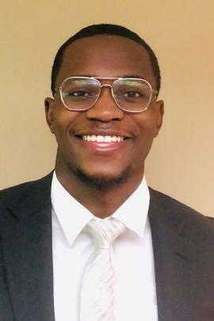
Connect with us!
What additional information do you need to decide to join the SDOH LC?
Schedule a one-on-one with us to go over any questions.
Send questions, comments or requests for additional support in this process to qip-nj@pcgus.com.

Slide 31
Q&A
What additional information do you need to decide to join the SDOH LC?
Schedule a one-on-one with us to go over any questions.
Send questions, comments or requests for additional support in this process to qip-nj@pcgus.com.

