Slide 1
QIP-NJ Dashboard User Tutorial
User guideline to navigate through the QIP-NJ Dashboard.
Last updated September 23rd, 2022
Notes:
Slide 1:
Welcome to the QIP-NJ Dashboard User Tutorial. By the end of this tutorial, you will understand how to access the QIP-NJ Dashboard, how to find your hospital-specific measure results for baseline, how to create a cohort for comparison to other hospitals on individual measures, and how to consider your performance in the context of your hospital’s individual targets for each measurement year.
The QIP-NJ dashboard is designed to help hospitals to visualize performance results and trends over time, and to support the transition towards population health management. At the time of this recording, the dashboard only contains data collected on the baseline period, July 1, 2020 – December 31, 2020. This dashboard will be evolving as more data becomes available to support more in-depth analysis and to assist hospitals in projecting eligibility for payment.

Slide 2
Where to Find the Dashboard
https://qip-nj.nj.gov/Home/dashboard
Notes:
The dashboard can be found on the dashboard tab of the QIP-NJ website, and requires a tableau log-in to gain access. Only hospital representatives are being granted access to this dashboard at this time. If your hospital does not have access, please reach out to the QIP-NJ inbox, and a log-in will be created for you.

Slide 3
Content
Introduction | General information about the QIP-NJ Dashboard: What you can do and what you can’t do with the dashboard How to get help when you have questions or concerns
My Hospital’s Performance | View your hospital’s baseline performance, Measurement Year 1 (MY1) targets, and statewide targets across all measures.
Hospital Performance Across the State | Compare performance of QIP-NJ hospitals by filtering on: Hospital system Participation in behavioral or maternal health components Relative Medicaid Percentage (RMP) Number of beds
Projecting My Hospital’s Future Performance Targets | View your annual performance targets and a pathway to future targets by entering different projected value for MY1 Performance.
Don’t forget to always hover over the data points and labels for additional information!
Notes:
The dashboard is divided into 4 tabs:
An introduction that explains what can and can’t be done using the dashboard, and answers to some frequently asked questions from the early launch of the dashboard.
The “My Hospital’s Performance Tab” is where you will find the final post-appeals performance results for each individual hospital. In future years this will also include performance against hospital individual targets.
The “Hospital Performance Across the State” tab can be used to compare your hospitals performance to other similar hospitals, based on a variety of criteria such as hospital system, Relative Medicaid Percentage, or number of beds.
Finally, the “Projecting my Hospital’s Future Performance Targets” tab can be used to evaluate the impact of different MY1 performance scenarios on a hospital target for years 2 through 5. This will continue to be updated as we receive performance data for each subsequent year.
Each of these tabs can be accessed by selecting among the grey boxes at the top of the dashboard.

Slide 4
Tab 1: Introduction
Scroll down for more information
Notes:
Navigating to the first tab: this tab provides general information on the dashboard, and how it can be used. Please take a moment to read through these instructions, as they will help you to best understand the dashboard, and will provide important information on how to make the most of your hospital’s data.

Slide 5
Tab 2: My Hospital’s Performance
Hover over the chart for more details.
Click on the dropdown arrow for a list of hospital names
The bar is Baseline Performance, the dot represents MY1 Target, and the dash is the Statewide Target.
Data will only be displayed for measures on which data was available.
Orange Bar: The baseline is met.
Grey Bar: The baseline is not set.
There’s no MY1 target if baseline is not set.
Notes:
The first step in reviewing your hospital's baseline performance on the QIP-NJ measures is to select your hospital’s name from the dropdown at the top of the page. Simply click on the dropdown arrow to select your hospital from the options below. This filter will be applied to the entire tab once you select a hospital from the list. Only the measure sets your hospital is participating in will appear in the table. For example, if your hospital does not have a Labor and Delivery unit and is not participating in maternal health, then there will not be any maternal health measures displayed in the table.
The pie chart at the top of the page indicates on how many measures your hospital has already met the statewide target, and on how many measures there is still room for improvement.
There are no performance targets for BH10, BH11, M8, and M9, so these measures are not included in the pie chart.
Below the pie chart in the main table is the performance results for each measure your hospital is participating in. Just like in the pie chart above, orange indicates measures where the statewide target has been met, and blue indicates where there is still room for improvement. Where performance on a measure has not yet exceeded the statewide target, MY1 targets are represented by a blue dot.
A grey bar indicates that the denominator for the final post appeals result was below 30, and a baseline has not been set. These measures will not contribute to a hospital’s payment calculation for MY1, but if in future measurement years a denominator above 30 is achieved, a baseline will be set for the measure.
Measures with a downward improvement direction are displayed separately from upward improvement measures to best characterize their performance. For downward improvement measures, if the performance is lower than the statewide target (indicated by the black dash on the chart) then the statewide target is met. Where statewide targets are not met on downward improvement measures, a blue dot appears below the chart to indicate the MY1 target.

Slide 6
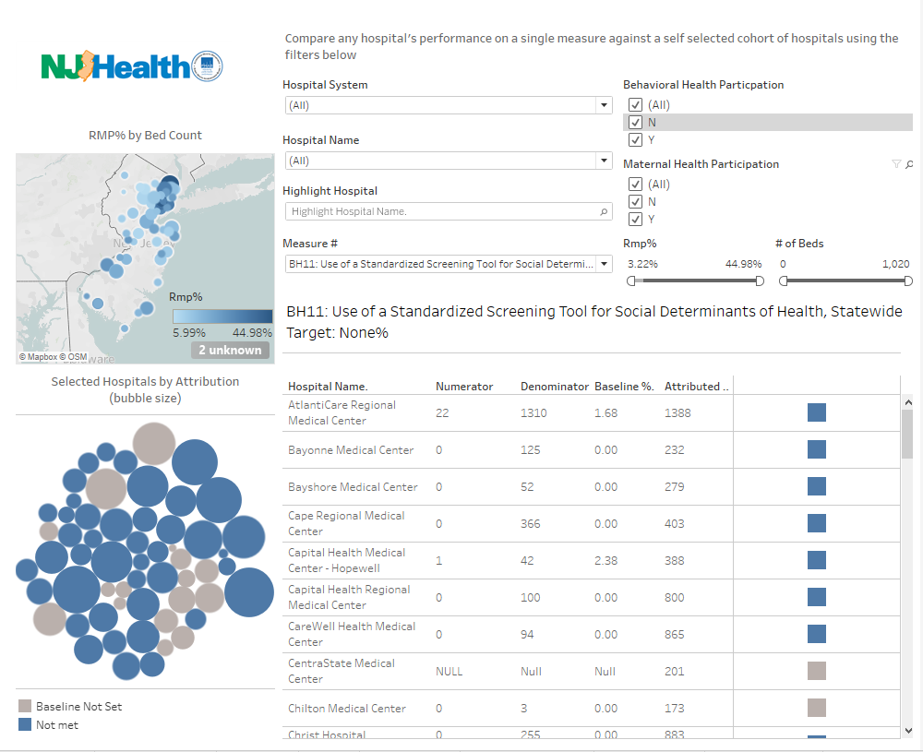
Tab 3: Hospital Performance Across the State
Use the filters to create a cohort with hospital system, hospital name, and measure name.
Highlighting a hospital helps visualizing a hospital in both graphs on the left.
This dashboard displays only one measure at a time.
Filter on behavioral or maternal health participation.
Change the parameter on Relative Medicaid Percentage and Number of Beds.
Hover over the bubble for hospital baseline performance, attribution, denominator, and numerator information.
Scroll down for more information on the selected measure.
Notes:
The “Hospital Performance Across the State” tab allows users to view multiple hospitals’ performance on a single measure, to better compare performance across the state or across a subset of hospitals.
Filters used to select a cohort of hospitals for comparison are located on the top right of the tab and are applied to the entire tab once selected. When you first click on this tab, it is set to display all hospitals by default. You can select specific hospitals by applying hospital-related filters such as Hospital System, Hospital Name, RMP %, and # of Beds as well as a highlight hospital function. The Hospital System filter allows you to view hospital performance within the system you selected. This filter allows multiple selections at the same time, which means you are not only able to compare hospital performance across a single system but multiple systems. However, once you selected the hospital systems, the Highlight Hospital function will only display hospitals within the systems that were selected. The Highlight Hospital filter highlights the hospital on the entire tab with color while greying out others, which will help spot the specific hospital’s performance quickly. You can also use the Hospital Name filter to compare multiple hospitals’ results. Before selecting the Hospital Name filter, you must select ALL on the Hospital System filter and remove the highlight to ensure you can see your selected results.
Lastly, you can filter hospitals by changing the scales on the RMP and the Number of Beds parameters. For example, if you want to see only hospitals that fall between the Relative Medicaid Percentage range of 15 to 25%, you can adjust the scale by dragging it along until the percentages on the top of the scale show 15% and 25%, or you can simply click on the numbers and enter 0.15 and 0.25 for the percentages.
You can identify hospitals by the measure set-specific filters as well. For example, you can display hospitals that only participate in Behavioral Health by selecting Y (Yes) on Behavioral Health Participation and N (No) on Maternal Health Participation. Note: that if you choose to only show hospitals that are not participating in a measure set, if you select one of the measures from that set in the measure filter, no results will display.
The map on the top left displays the location of each hospital selected using the drop-down menus at the top of the page. The Relative Medicaid Percentage (RMP) of the hospitals is indicated by the shade of the bubble according to the scale on the lower right corner of the map. The deeper the color is, the larger the RMP. The size of the bubble indicates the number of beds in the hospital. The larger the bubble is, the more beds. When hovering the mouse over the map, you will see a toolbar on the left that will allow you to zoom in or zoom out and move the map around. More detailed information about each hospital will be displayed when hovering over the bubbles, such as hospital name, zip code, bed count, and Relative Medicaid Percentage .
The bubble chart below shows MY0 performance for each of the hospitals selected using the drop down menus at the top of the page. The color coding is the same as the previous tab (orange indicates measures where the statewide target has been met, and blue indicates where there is still room for improvement. Grey indicates that the denominator for the final post appeals result was below 30, and a baseline has not been set). The size of the bubble indicates the hospitals’ attribution, relative to the other hospitals selected. More detailed information about the hospital will be displayed when hovering over the bubbles, such as hospital name, MY0 performance (in percentage), attribution, denominator size, and numerator size.
The list on the bottom right of the page provides each hospital’s individual performance on the selected measure. Above the list of hospital results, is the name of the selected measure being displayed, and the statewide target, as a percentage. This tab only displays a single measure at a time. If you wish to visualize performance on a different measure, you can switch by using the Measure # and Name filter above the list.
Hospital names, numerator size, denominator size, the baseline performance, and the number of attributed members are displayed in columns. You can sort the list in a specific order by clicking on the icons next to the column names. For more information, you can hover over the squares on the right to see if the hospital has met the statewide target yet based on the baseline performance. If you have selected more hospitals than will display in the window, you will need to scroll within that section of the page to see all the results.

Slide 7
Tab 4: Projecting My Hospital’s Future Performance Targets
Input a hypothetical MY1 performance value in this box to view a potential pathway for meeting the measure’s statewide target in 5 measurement years.
The chart on the left shows a pathway for meeting the statewide target based on baseline performance, while the chart on the right shows the pathway for meeting the target based on a hypothetical MY1 performance.
Notes:
The last tab provides a view of the hospitals’ annual performance as well as a pathway to future targets based on a projected MY1 performance value. You will be able to select your hospital and a specific measure to view with the two filters above the charts: Hospital Name and Measure name and number. The MY1 Performance Projection box allows you to input a hypothetical value for MY1 measure performance and visualize the impact on performance targets moving forward. The chart on the left shows a pathway for meeting the statewide target in the next five measurement years based on baseline performance, while the chart on the right shows a pathway for meeting the target in the next four measurement years based on the baseline performance and a hypothetical MY1 performance entered. Once the statewide target is met, the targets for the rest of the measurement years will be displayed as the statewide target. For example, the target for BH7 is 80%, if a hospital’s baseline performance was 90% and you entered 15% for the MY1 Performance Projection, the left chart will display 80% for measurement years 1 through 5, while the chart on the right will display 90% for MY0, 15% for MY1, and 80% for the rest of the measurement years. There are no performance targets for BH10, BH11, M8, and M9, therefore, these measures will not have a projected pathway. At this time, the dashboard only contains data collected on the baseline period and it will be updated when more performance data becomes available for each subsequent year.

Slide 8
Tab 4 Continued: Scoring Methodology Explained
Scroll down for more information on scoring methodology.
Notes:
Below the charts, the scoring methodology is explained in detail, with examples. Please take a moment to read through this section, as it will provide best understanding the target calculation for each measurement year based on the gap closure methodology.

Slide 9
Dashboard Development
After MY1 submissions are finalized, and the appeals process is completed, the dashboard will be updated to reflect performance against MY1 targets (rather than the statewide target).
If hospitals have any recommendations for enhancements to the dashboard, please reach out to the QIP-NJ Team: QIP-NJ@pcgus.com
Notes:
While this presentation reflects the dashboard in its current state, there are many future developments planned. As stated earlier in the presentation, the dashboard only currently contains baseline data as compared to statewide targets. At the completion of the MY1 data submission and appeals processes, the dashboard will undergo significant maintenance to incorporate MY1 performance data, and to indicate hospital eligibility for MY1 payment, and to recalibrate performance against individual targets rather than the statewide target.

Slide 10
Questions or Concerns
Please contact QIP-NJ@pcgus.com with any questions or to report problems with the Dashboard.
Thank you!
Notes:
I hope that this overview of the QIP-NJ dashboard has been helpful. As always, if you have any questions or concerns, please contact the QIP mailbox at QIP dash NJ @ PCGUS.com and we will respond to your inquiry as soon as possible. Have a wonderful day!

