Slide 1
Template Instructions
Please complete this storyboard template for the second Learning Session using the instructions on each slide which are in green writing.
Please submit completed storyboard to QIP-NJ@pcgus.com by 12:00pm ET on Tuesday, January 24th, 2023.
Please consider you will have 8 minutes to share your story board and ensure the content included can be covered in that time.
Feel free to use your system’s branding and PPT templates for the submission.

Slide 2
QIP-NJ Maternal Health Learning Collaborative (MLC) Learning Session 2 Storyboard Date TBD Insert: Hospital Name, Location
(Please feel free to add slide backgrounds, photos, graphics etc. where appropriate)

Slide 3
Team
Tell us about your team (please list your team members).
Consider including a photo of your team.
Notes:
Picture of team?

Slide 4
Aim During Action Period 1
Please state your team’s specific aim(s) and what your team was working toward during Action Period 1 (October 2022 – January 2023). Would you change this for AP2? Do you have an additional aim to add?
-- Tip: Aims should answer the questions “How Good? For Whom? By When?”
Tell us your aim headline: What is a newspaper headline that would sum up your progress in Action Period 1?
Notes:
Consider moving this up. Photos representing communities served .
What does equity mean? What is already going on to address equity at your hospital.

Slide 5
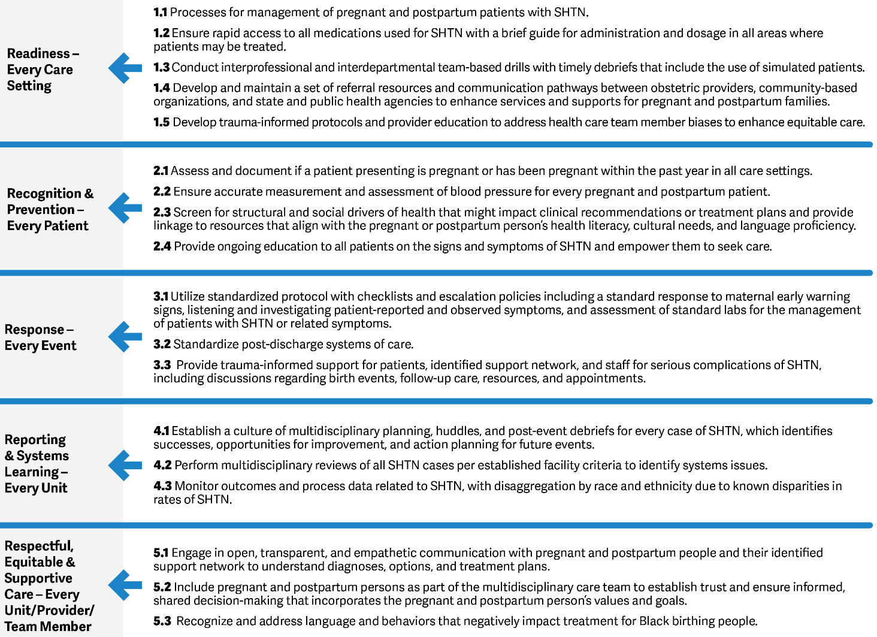
Key Driver Diagram Identification
Please select which secondary drivers represent your main focus during Action Period 1 by placing a star icon(s) over the drivers you are focusing on. This will help us pair teams for the Storyboard Breakouts.

Slide 6
Exploring Current State
If you have used process maps or other QI tools, please share here. How have they informed your tests of change or identified opportunities for improvement?
Insert any other work you did to understand the areas of opportunity in your system.
Notes:
Could we add a prompt for Asks and Offers? What do you want to learn? What can you teach others?

Slide 7
PDSAs: Changes Tested in Practice
In a few bullets, summarize the Plan-Do-Study-Act cycles you ran with your team, describing the changes you tested in practice and the outcome of those changes.

Slide 8
Current Performance
Display any key data you have that reflects either:
--The outcome of your PDSA cycles;
--Reflections on disparities discovered by stratifying data by race/ethnicity;
--Data for any of the Collaborative Measures:
https://qip-nj.nj.gov/Documents/MLC/Measurement_Strategy_MLC_Final.pdf
Optional: If you have baseline data to share, please include here. Run charts showing data over time are preferable. Please include no more than two data slides

Slide 9
Engaging Patients and Partners
Describe any highlights from your effort to engage patients and/or community providers in your Collaborative work to date.
Consider including photo(s) that represent the community you serve
Notes:
Could we add a prompt for Asks and Offers? What do you want to learn? What can you teach others?

Slide 10
Lessons Learned
Please conclude with any key takeaways that either reflect your success so far or highlight gaps you have identified that must be overcome.
Notes:
Could we add a prompt for Asks and Offers? What do you want to learn? What can you teach others?

